Slide 1

E-Commerce Retail Data Analysis: Uncovering Revenue Patterns and Customer Behaviour
By Filzah Annisa
Notes:
Line spacing + Page numbers

Slide 2
Agenda
01 Business Overview
02 Objective & Goals
03 Analysis
04 What’s Next?

Slide 3
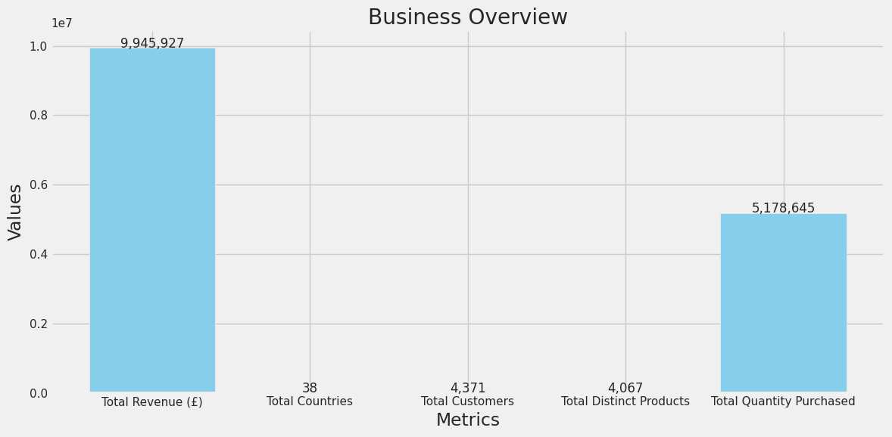
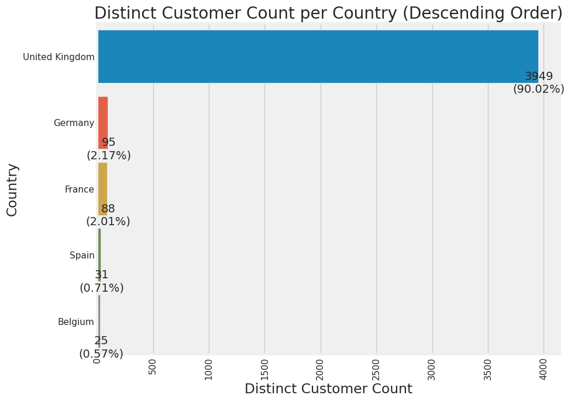
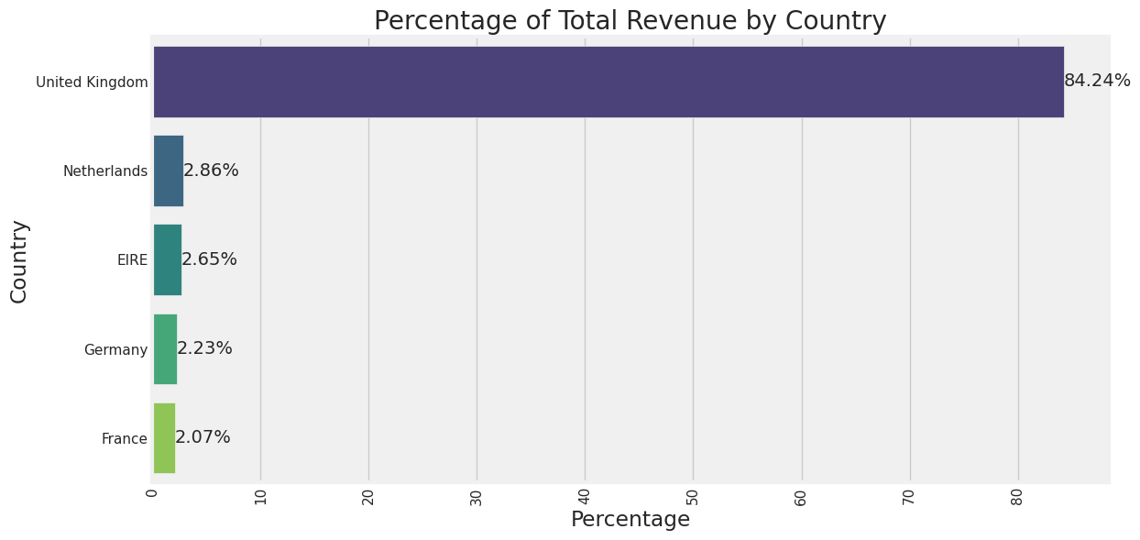
Business Overview – High Level
01
The top 5 countries generate:
94.05% of total customers
95. 48% of total revenue
: Best

Slide 4
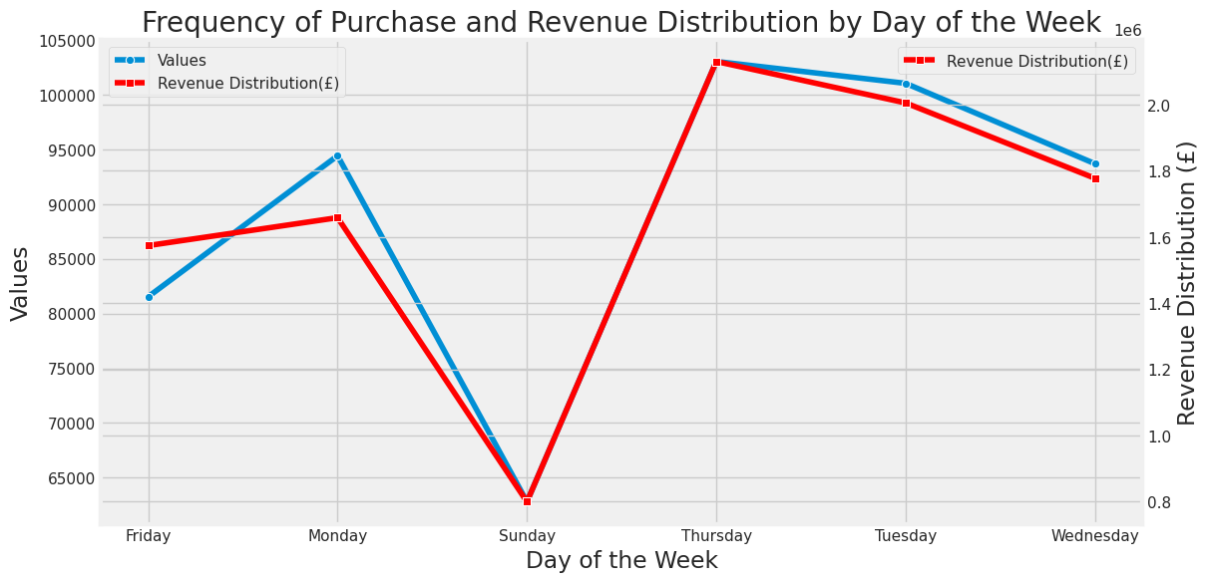
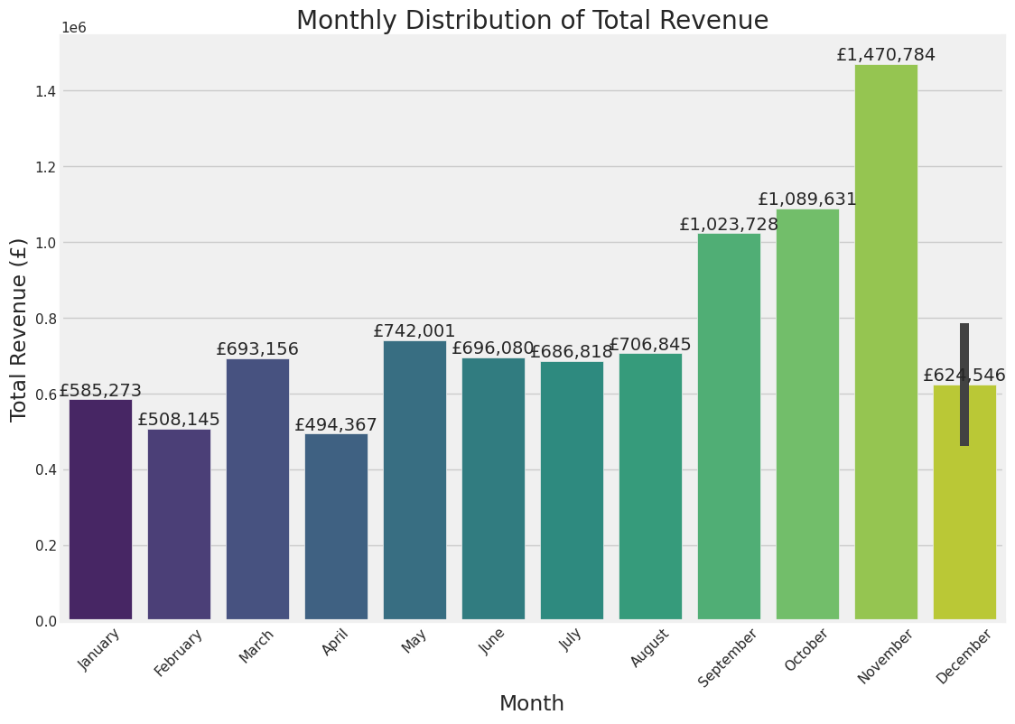
01
Business Overview – Patterns
Thursday is the TOP purchasing day
Followed by Tuesday
Saturday seems to be holiday for the store, no revenue generated
November is the best month for sales
: Best

Slide 5
01
Business Overview – Product Level
Best Seller Products | Quantity purchased
SMALL POPCORN HOLDER | 56.427
WORLD WAR 2 GLIDERS ASSTD DESIGNS | 53.751
JUMBO BAG RED RETROSPOT | 47260
mailout | 44024
WHITE HANGING HEART T-LIGHT HOLDER | 39103
Which ones are Best sellers?
Which ones are best for our business?
BEST SALES PRODUCTS | TotalRevenue
DOTCOM POSTAGE | £ 206.245
REGENCY CAKESTAND 3 TIER | £ 164.459
WHITE HANGING HEART T-LIGHT HOLDER | £ 99.790
PARTY BUNTING | £ 98.243
JUMBO BAG RED RETROSPOT | £ 92.175

Slide 6
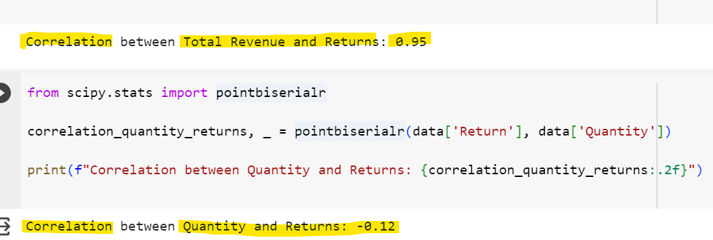
01
Business Overview – Returns
Product Name | Returned Quantity
Manual | 241
REGENCY CAKESTAND 3 TIER | 183
Unknown | 97
JAM MAKING SET WITH JARS | 87
SET OF 3 CAKE TINS PANTRY DESIGN | 75
STRAWBERRY CERAMIC TRINKET BOX | 60
SAMPLES | 60
A lot of products (241) were returned manually so we couldn’t find out the exact product name.
Some are Unknown
All samples were returned. In the future we do not need to sent out samples anymore.
5.52% products are returned.
It seems that customers with more returns = more revenue
But more quantity purchased =/= more or less returns

Slide 7

What do we want to achieve?
02
Objective

Slide 8
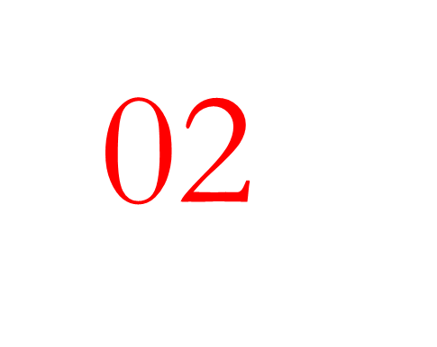
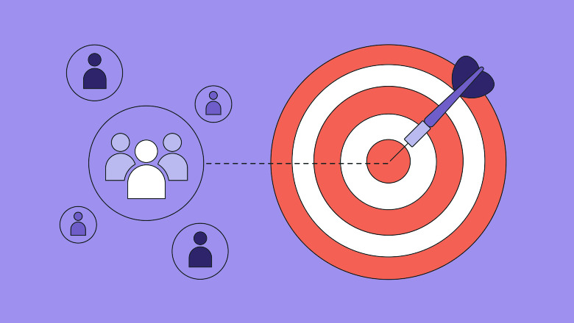
HOW?

Slide 9
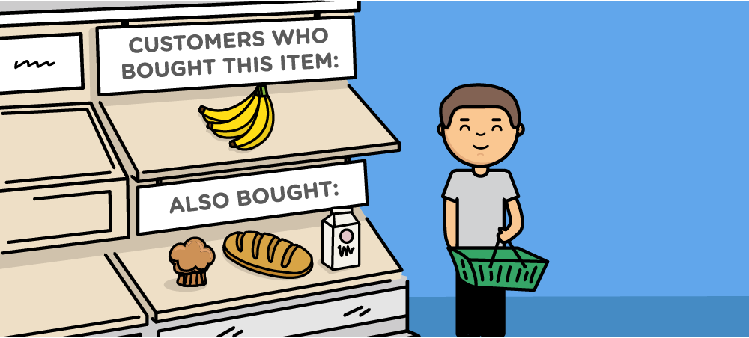
Analysis
03
The Right Target
The Right Products

Slide 10
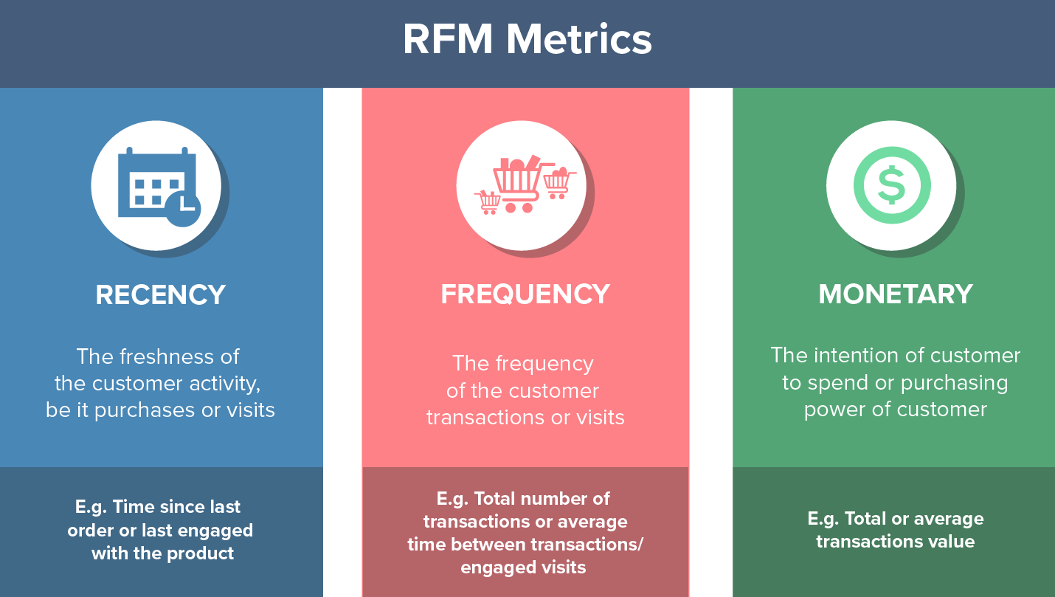
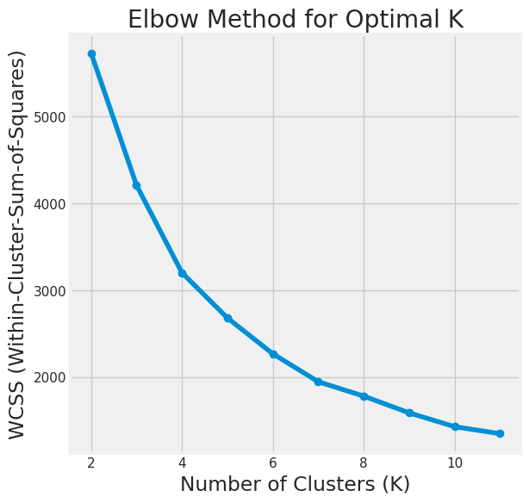
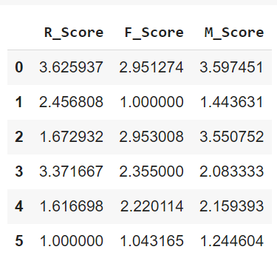
The Right Target: Customer Segmentation with RFM
03
K-Means to decide # of clusters
My RFM scores range from 1-4
1: HIGHEST/BEST
4:LOWEST / WORST
: Best

Slide 11
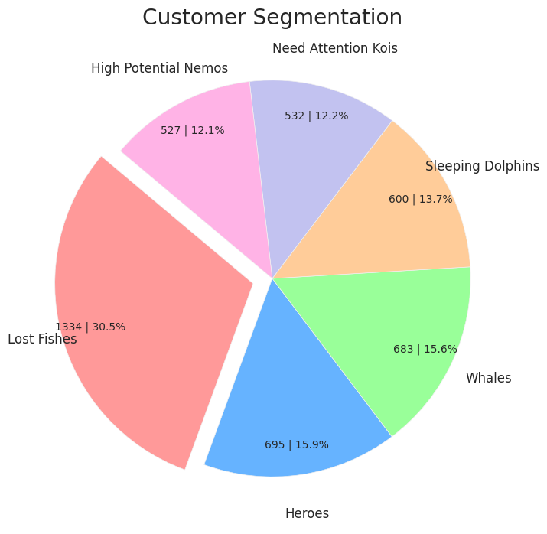
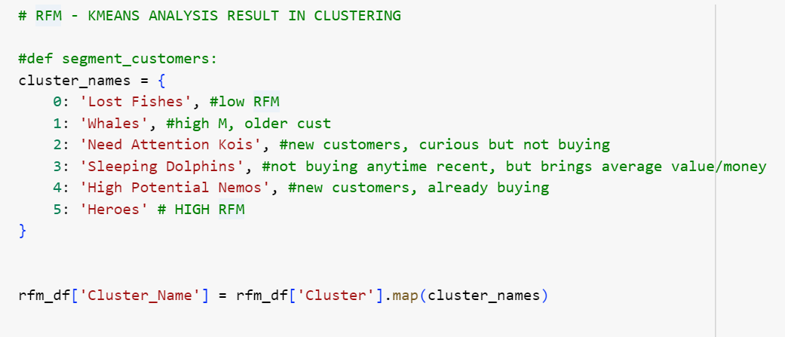
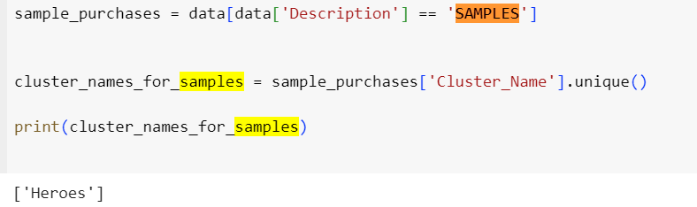
The Right Target: Customer Segmentation with RFM
03
Code snippet:
I noticed only ‘Heroes’ customers receive samples
Cluster # | Customer Segmentation | Definition
0 | Lost Fishes | customers who are not buying from the business at all now
1 | Whales | Customers that bring high volume of revenue, but not buying that recently
2 | Need Attention Kois | NEW customers who are already actively buying and brings revenue into our business
3 | Sleeping Dolphins | Customers who have bought considerable amount, but not anymore
4 | High Potential Nemos | NEW customers who are not buying
5 | Heroes | Customers who actively brings revenue into our business and purchase frequently

Slide 12
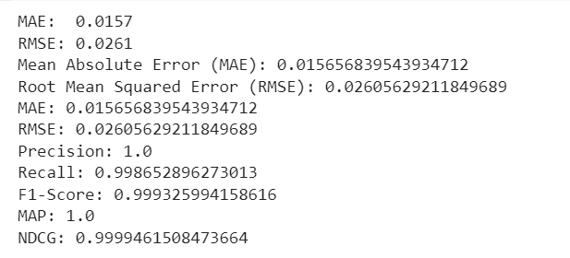
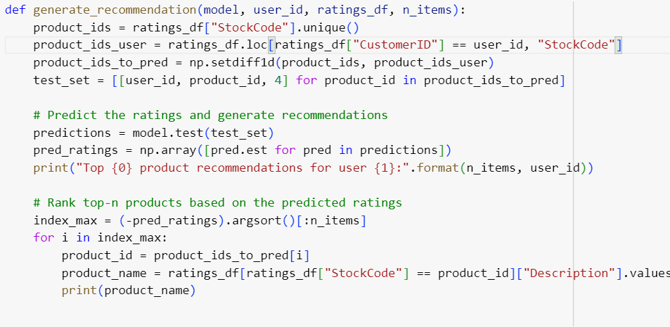
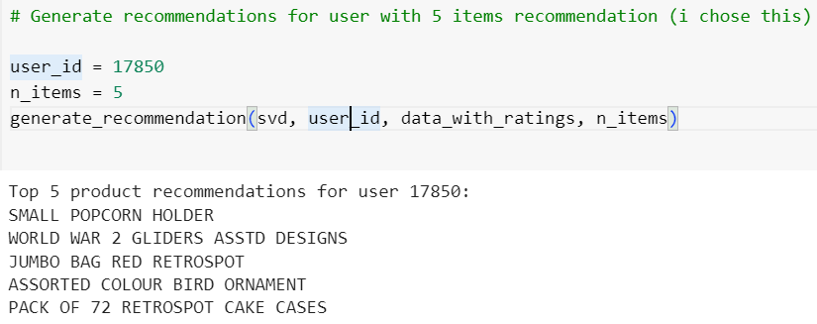
The Right Product: Recommender systems using
Collaborative Filtering
03
Code Snippet:
Case Example:
Results:
The recommendation system is performing exceptionally well and is effective in providing relevant product recommendations to users.

Slide 13
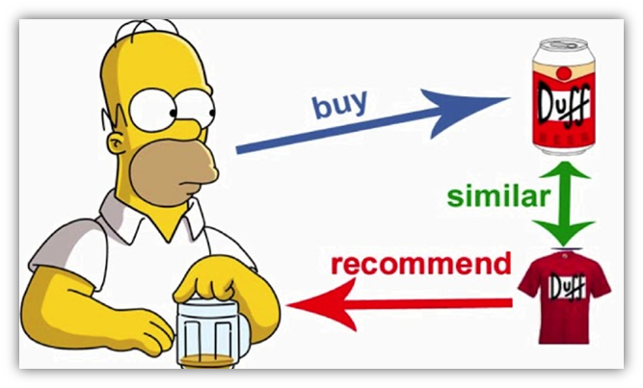
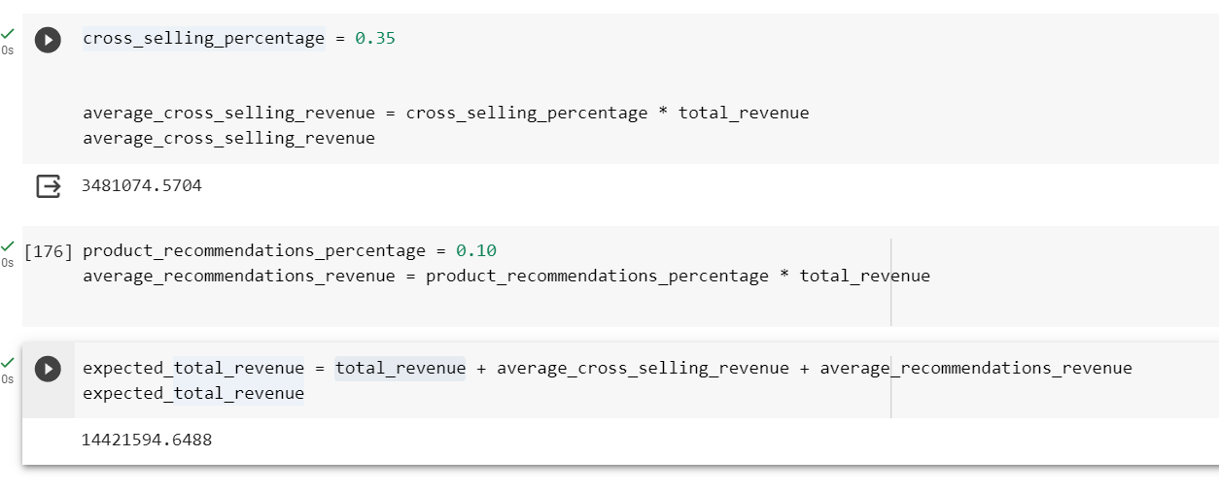
The Right Product: Recommender systems using
Collaborative Filtering
03
*Amazon has reported that the business of cross-selling and upselling make up as much as 35% of its revenue.
Product recommendations are responsible for an average of 10-30% of eCommerce site revenues.
Lowballing this data. If we use system recommendation and the right marketing strategies, we could:
Increase revenue up to 45%
Increase of up to £ 4.475.667
*https://vwo.com/blog/use-upsell-cross-sell/

Slide 14
What’s next?
04

Slide 15
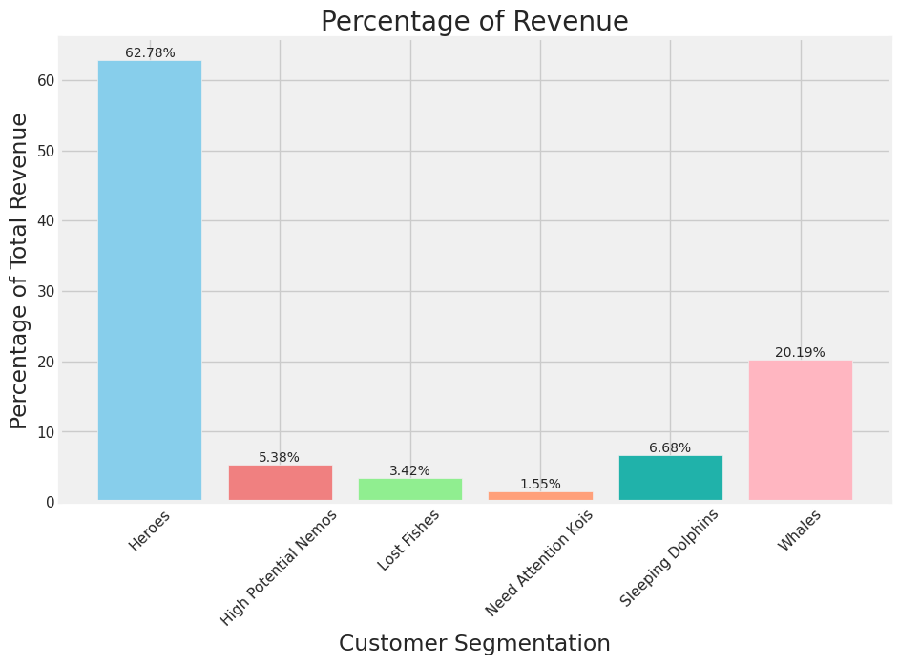
Summary & Action Recommendation
04
The business had a problem retaining and taking care of their current older customers.
30% of lost customers have to be treated like a new customers IF we would like to re-activate them. Since they likely to have forgotten about our business.
Being a UK-based business. It makes sense for UK to be the biggest contributor in terms of customer and sales
No more samples for customers. All samples sent out were returned = not the right approach
Saved money: £ 3.039
Based on R-F-M Scoring, there are 6 segments of customer. (1 being lost):
From most important to least
Heroes
Whales
Sleeping Dolphins
High Potential Nemos
Need Attention Kois
Lost Fishes
: Best

Slide 16
Growth Strategies per Customer Segment: High Prio
04
Customer Segment | Priority | Customer Traits | Action Recommendation | Channels
Heroes | HIGHEST | Loyal, Frequent Buyer, Big Spender | TOP priority in customer service: Special membership, loyalty programmes and perks, cross-sell in webshop carts, webshop pages or (post-purchase) via e-mail marketing, exclusive products introduction, product newsletter | Sales & Marketing
Whales | HIGH | Frequent Buyer, Big Spender | Focus on making them into HEROES: cross-sell via e-mail marketing & webshop marketing, new products introduction, newsletter about interesting products, entice them into joining loyalty programmes | Sales & Marketing

Slide 17

Growth Strategies per Customer Segment: The Rest
04
Customer Segment | Priority | Customer Traits | Action Recommendation | Channels
Sleeping Dolphins | MID | May Forget Us, Average Spending | Mass Direct Marketing: introduce interesting products via email, with survey to understand why they are sleeping, offer discounts or promotions (1+1) on relevant products, newsletter email marketing. | Omni-channel Marketing
High Potential Nemos | MID | Newcomers, Curious, Whales Potential | Customer support to introduce products, onboard webshop, newsletter for products+cross-selling marketing, special promotion for a short period of time to make them interested to become loyal. | Omni-channel Marketing
Need Attention Kois | LOW | Newcomers, could be Lost fishes if not taken cared of. | newsletter for products + cross-selling marketing, emails about special promotion for a short period of time to make them interested to make a purchase. | E-mail marketing
Lost Fishes | - | No sales, no visits | Minimum to no effort: email newsletter. We can also consider this as none customers. If they start making a purchase again, treat them as ‘need attention kois’. | E-mail marketing
Further analysis on webshop &omni-channel marketing interaction is needed in order to decide which channel, content, and funnel is the best way for customers.

Slide 18
REFERENCE & PYTHON CODING
Data used:
https://www.kaggle.com/datasets/atharvaarya25/e-commerce-analysis-uk
Python coding:
https://colab.research.google.com/drive/1vPfYMNCy1jHVTcA0XfM7zHP9J1T72piz#scrollTo=zX_cRm4Q5-YS

Slide 19

Thank you!

